Slide 1
The Circuit Analogy, But Real
Thomas and David

Slide 2
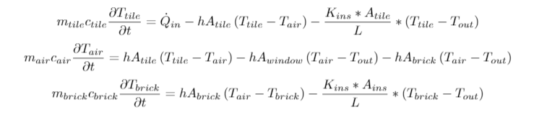
Assumptions and ODE’s
Solar input and outside temperature functions given
Uniform material temperature
Insulator does not store heat; heat flows through it
Sun only heats the tile inside, nothing else
House is on stilts

Slide 3
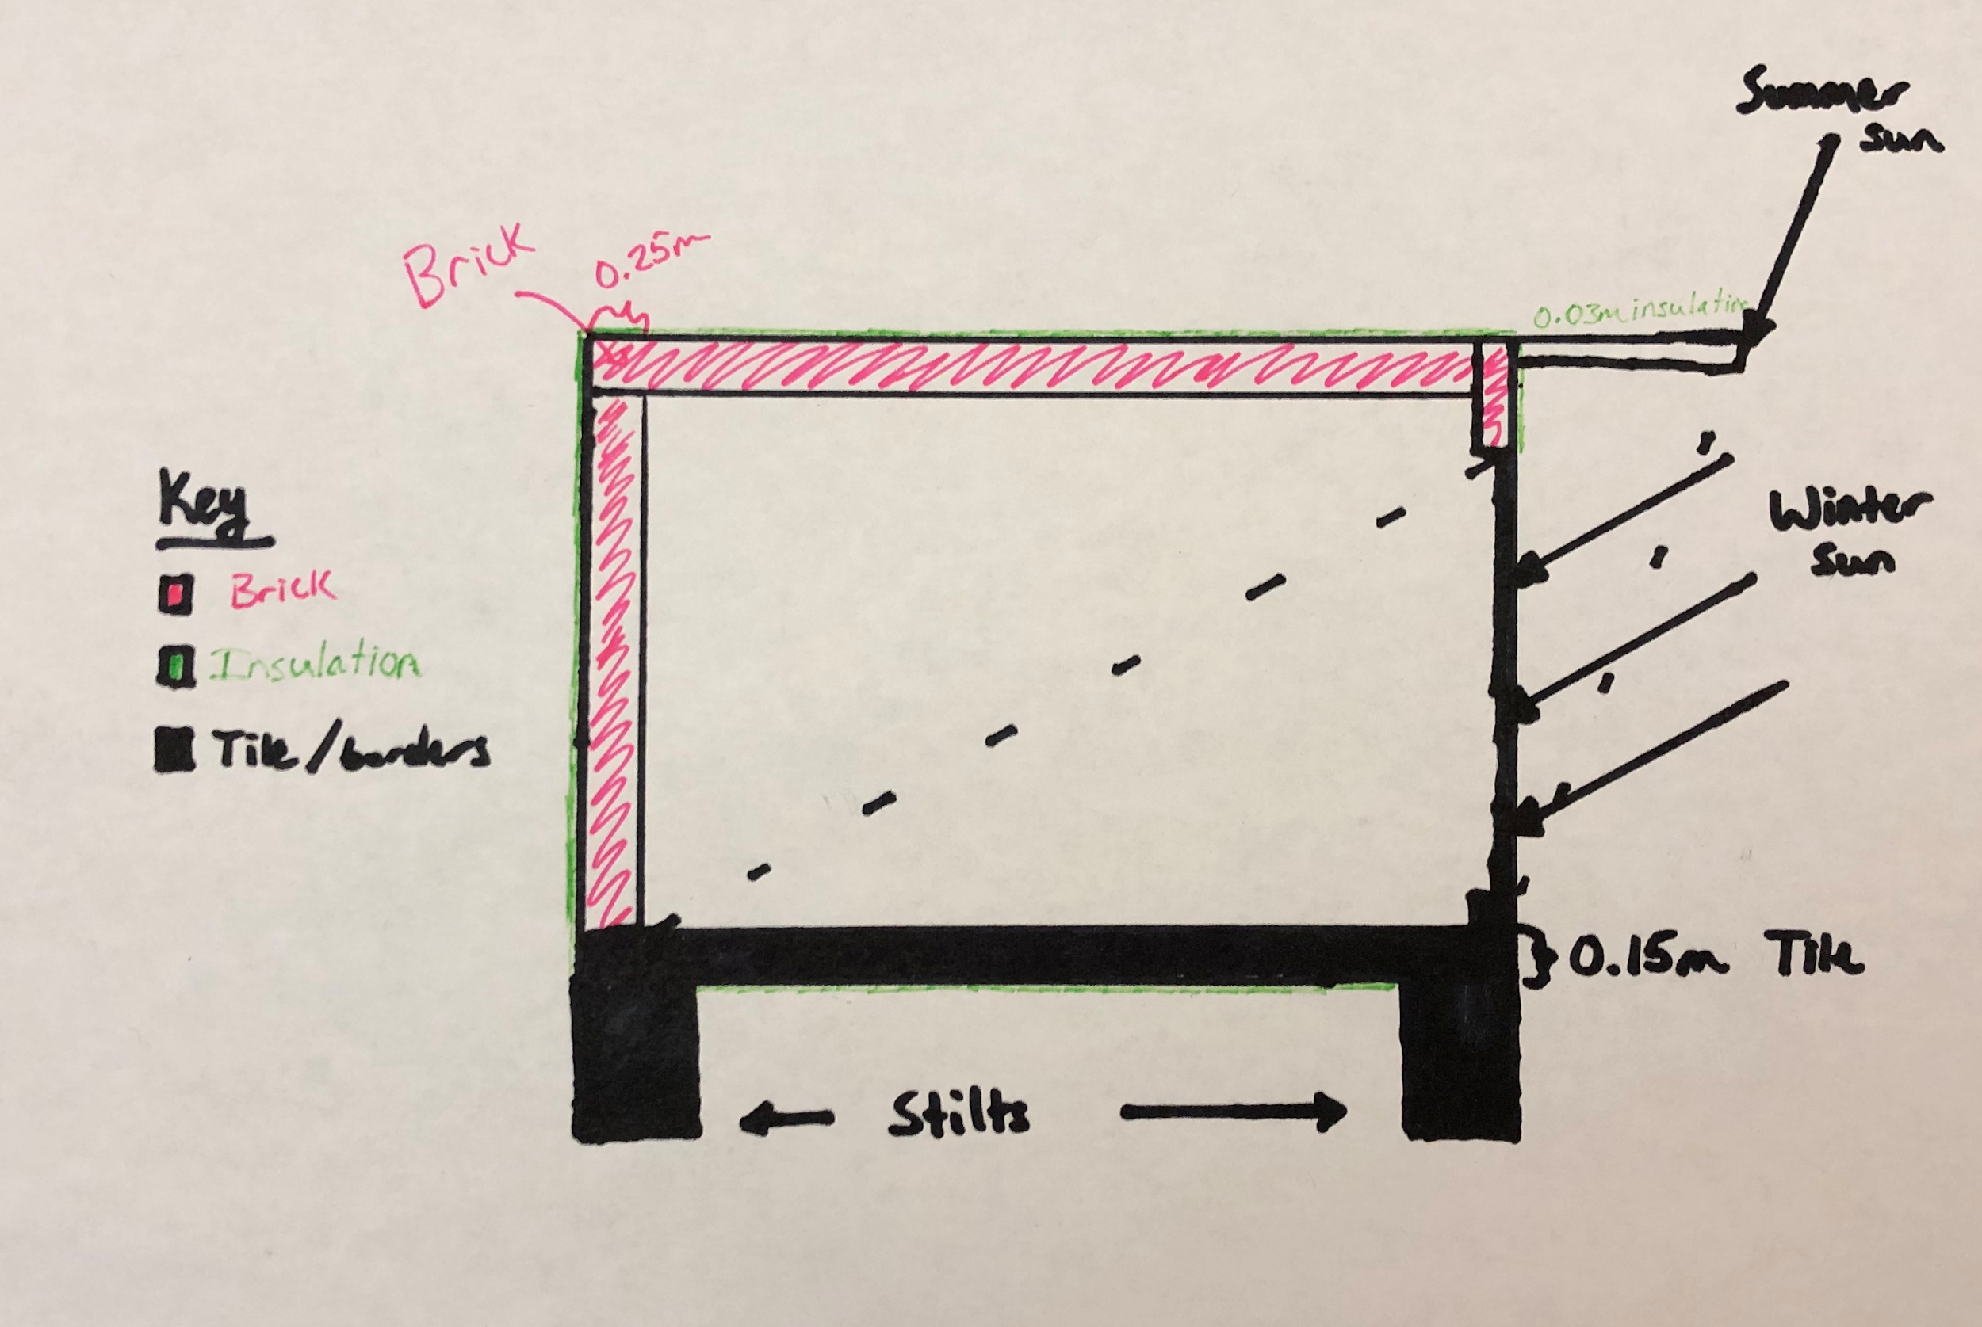
The Design
Floor tile is 15 cm thick, brick walls and ceiling 25 cm, 3 cm of insulation
Lots of thermal mass so low fluctuation
Little insulation and slightly unrealistic

Slide 4
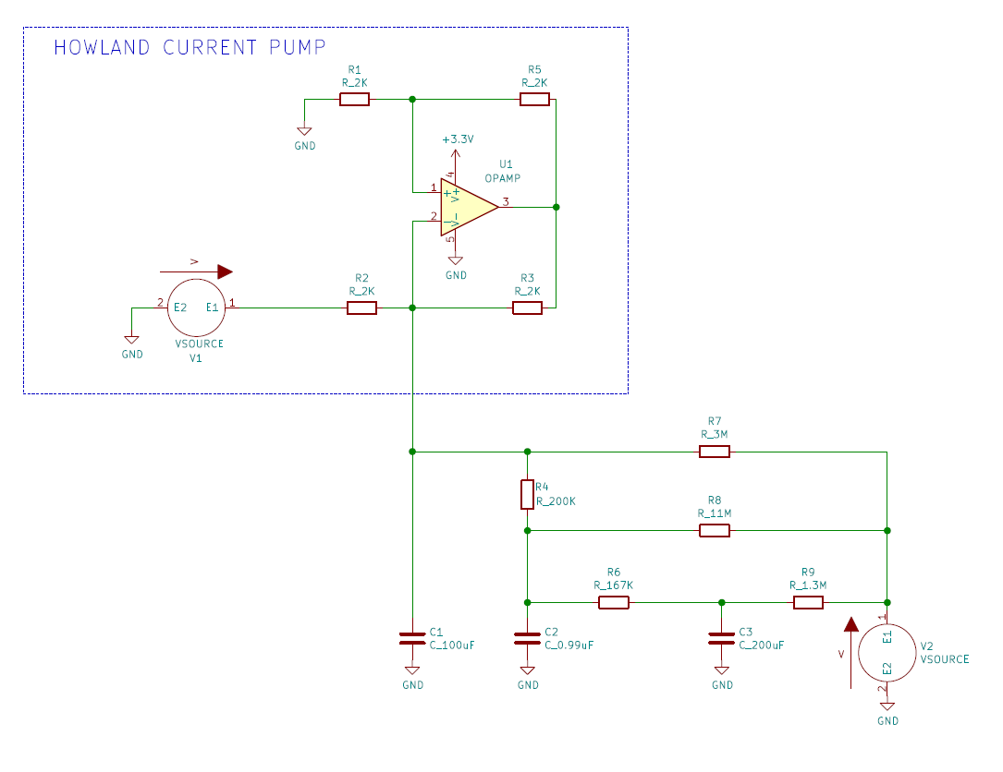
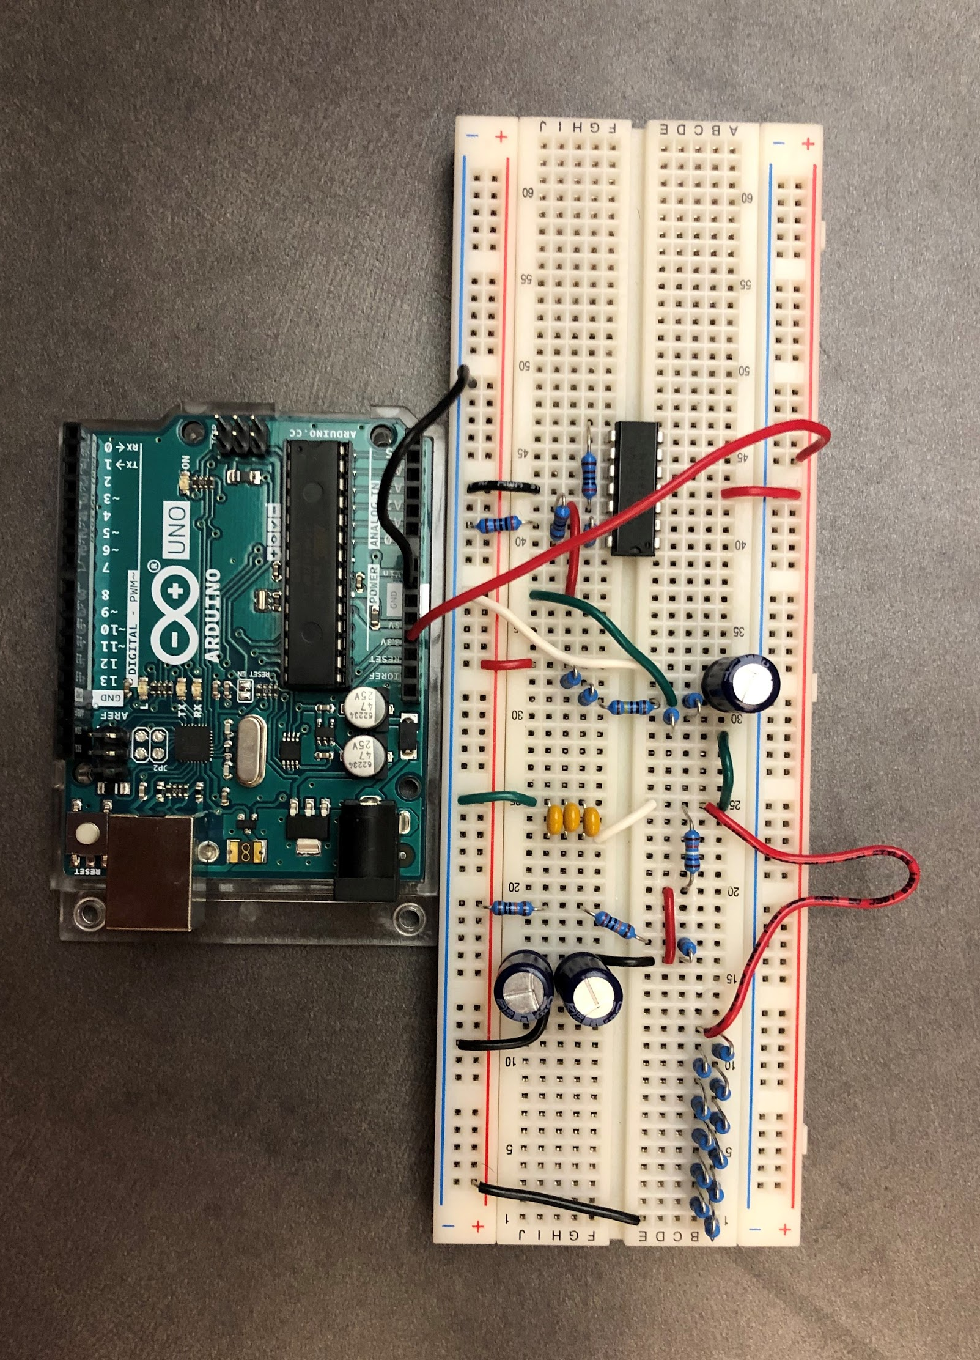
Circuit Model

Slide 5
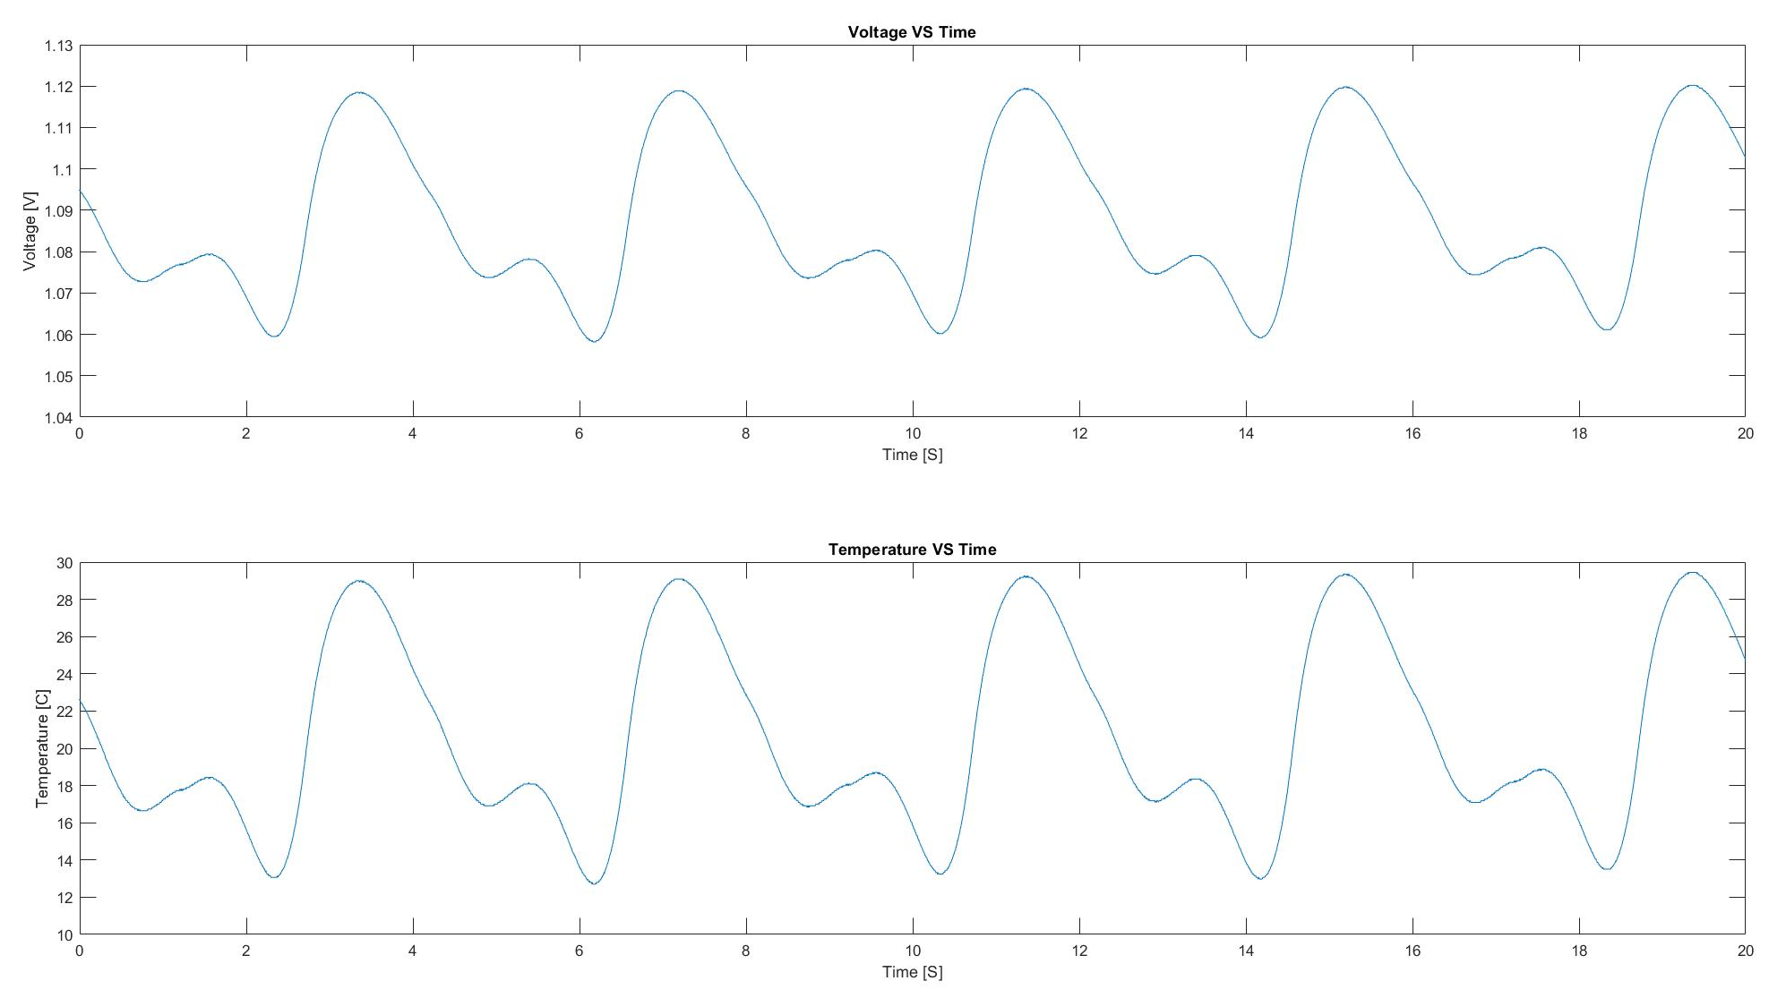
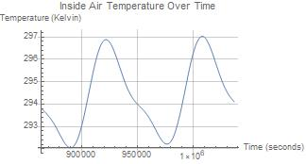
Findings
Note: 18 C = 291 K and 25 C = 298 K; Inaccuracies due to very small working voltage range and rounded resistor and capacitor values

